Slide 1
Model-based Reinforcement learning
Scott O’Hara
Metrowest Developers Machine Learning Group
09/12/2018

Slide 2
References
The material for this talk is drawn from the slides, notes and lectures from several offerings of the CS181 course at Harvard University:
CS181 Intelligent Machines: Perception, Learning and Uncertainty, Sarah Finney, Spring 2009
CS181 Intelligent Machines: Perception, Learning and Uncertainty, Prof. David C Brooks, Spring 2011
CS181 – Machine Learning, Prof. Ryan P. Adams, Spring 2014. https://github.com/wihl/cs181-spring2014
CS181 – Machine Learning, Prof. David Parkes, Spring 2017. https://harvard-ml-courses.github.io/cs181-web-2017/
As well as notes and lectures from Stanford course CS229 :
CS229 – Machine Learning, Andrew Ng. https://see.stanford.edu/Course/CS229

Slide 3
Overview
Overview
Types of Machine Learning
Markov Decision Processes
Reinforcement Learning
Applications
Review of MDP Algorithms
The Bellman equations
Expectimax (finite horizon)
Value Iteration (finite horizon)
Value Iteration (infinite horizon)
Policy Iteration(infinite horizon)
Reinforcement Learning
The basic idea
Model-Based RL
Learning the reward and transition probabilities
Credit assignment
Exploration vs. exploitation
Next Time
Q-learning

Slide 4

Types of Machine Learning
There are (at least) 3 broad categories of machine learning problems:
Supervised Learning
$Data=\left\{\left(x_{1},y_{1}\right),…,\left(x_{n},y_{n}\right)\right\}$
e.g., linear regression, decision trees, SVMs
Unsupervised Learning
$Data=\left\{x_{1},,…,x_{n}\right\}$
e.g., K-means, HAC, Gaussian mixture models
Reinforcement Learning
$Data=\left\{s_{1},a_{1},r_{1},s_{2},a_{2},r_{2}… \right\}$
an agent learns to act in an uncertain environment by training on data that are sequences of state, action, reward.

Slide 5
Markov decision processes
Markov Decision Processes provide a mathematical framework for modeling decision making in situations where outcomes are partly random and partly under the control of a decision maker.
The initial analysis of MDPs assume complete knowledge of states, actions, rewards, transitions, and discounts.
<https://en.wikipedia.org/w/index.php?title=Markov_decision_process&oldid=855934986> [accessed 11 September 2018]

Slide 6
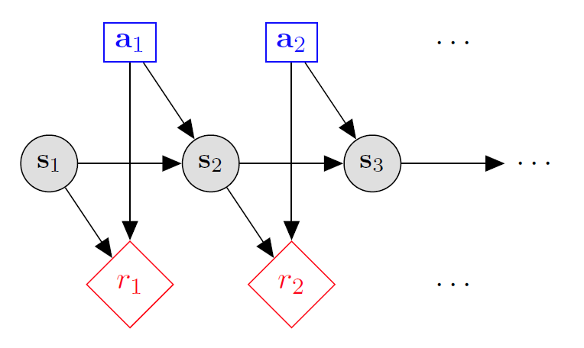

Markov decision processes
States: $s_{1},…,s_{n}$
Actions: $a_{1},…,a_{m}$
Reward Function: $r\left(s,a\right)∈R$
Transition model: $p\left(s′ | s, a\right)$
Discount factor: $γ∈\left[0,1\right]$
<https://en.wikipedia.org/w/index.php?title=Markov_decision_process&oldid=855934986> [accessed 11 September 2018]

Slide 7

MDP Goal: find an optimal policy π
GOAL: find a policy π that tells you what action to take in each state. We want to find ‘rewarding’ policies.
n state policy:
$$π\left(s_{1}\right)= a_{1}$$
$$π\left(s_{2}\right)= a_{2}$$
$$π\left(s_{3}\right)= a_{3}$$
…
$$π\left(s_{n}\right)= a_{n}$$

Slide 8
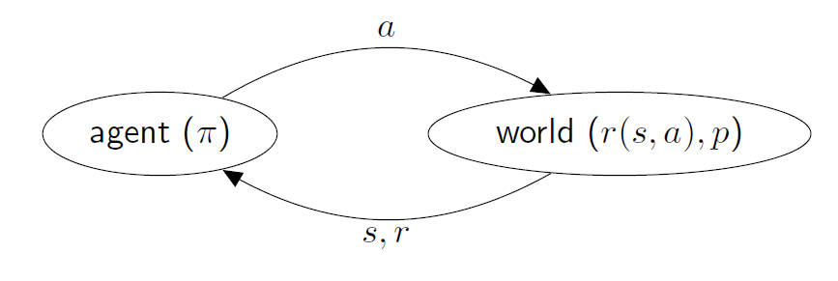
Reinforcement Learning
Agent knows the current state s, takes action a, and gets reward r.
There is no access to reward model r(s,a) or transition model p(s’|s,a)
Agent only sees the outcome reward r and the next state s’.
Under these conditions, it is a very challenging problem to learn π.

Slide 9
review of mdp algorithms

Slide 10

review of mdp algorithms
There are 4 standard MDP algorithms that assume complete knowledge:
Expectimax (finite horizon, $γ=1$)
Value Iteration (finite horizon, $γ=1$)
Value Iteration (infinite horizon, $γ∈[0,1)$)
Policy Iteration (infinite horizon , $γ∈[0,1)$)

Slide 11

bellman equations
The planning problem for an MDP is:
$$π^{∗}∈\underset{π}{arg max}{V^{π}(s)}$$
Bellman equations:
$V^{∗}\left(s\right)=\max_{a∈A}\left[R\left(s,a\right)+γ\sum_{s^{′}∈S}{P\left(s^{′} | s,a\right)V^{∗}\left(s^{′}\right)}\right], ∀s$
All MDP algorithms use some variant of the Bellman equations.

Slide 12
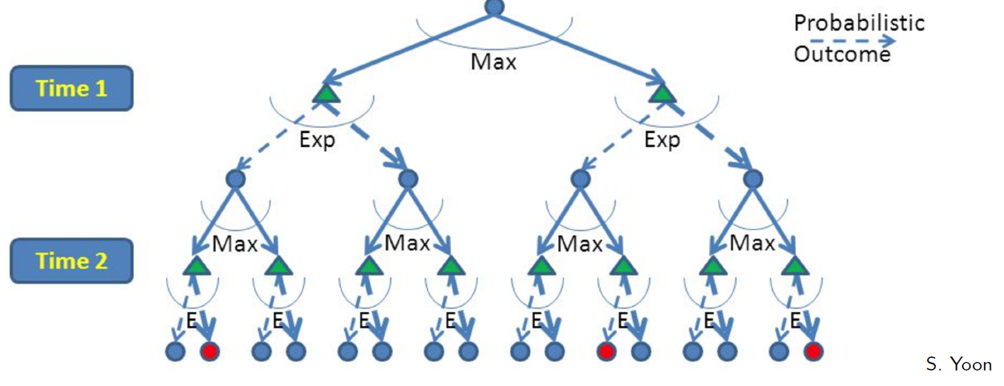
Expectimax: top-down, Recursive
Build out a look-ahead tree to the decision horizon; take the max over actions, expectations over next states.
Solve from the leaves, backing-up the expectimax values.
Problems: (1) computation is exponential in the horizon; (2) may expand the same subtree multiple times.

Slide 13
Expectimax: A game against Nature
Expectimax is like a game-playing algorithm except the opponent is nature.
Expectimax is strongly related to the minmax algorithm used in game theory, but the response is probabilistic.
Nodes where you move: S ( )
Nodes where nature moves: <S,A> ( )

Slide 14


expectimax ($Finite Horizon T$)
function EXPECTIMAX(s)
if s is a terminal then
return 0
else
return $\max_{a∈A}[R\left(s,a\right)+\sum_{s′}{P\left(s′ | s,a\right) EXPECTIMAX(s^{′})}$]
$$π^{T}(s)=EXPECTIMAX(s)$$

Slide 15

Value iteration ($Finite Horizon T$)
Value iteration with a finite horizon works from the bottom-up using dynamic programming.
The idea is to break up the problem by number of the number of steps to go.
Start with the base case values with no timesteps to go.
Given optimal policy for k-1 steps to go, compute values for k steps to go

Slide 16


Value iteration ($Finite Horizon T$)
For each state s, initialize $V_{0}\left(s\right)=0$
For $k←1…T$ {
For every state s:
$V_{k}\left(s\right)=\max_{a∈A}[R\left(s,a\right)+\sum_{s^{′}}{P\left(s^{′} | s,a\right)V_{k−1}\left(s^{′}\right)}]$
}
$π^{T}(s)=\underset{a∈A}{argmax}[{R\left(s,a\right)+\sum_{s^{′}∈S}{P\left(s^{′} | s,a\right)V_{T}\left(s^{′}\right)}}]$

Slide 17


Value iteration ($∞ horizon,γ∈[0,1)$)
Value iteration with an infinite horizon is a generalization of value iteration with a finite horizon.
The main change is that the discount factor $γ$ is set to less than one discounting the value of states farther in the future.
It can be shown that $V$ will converge over time to $V^{∗}$
Iterate the update equation until the changes in $V$ fall below some $ε$.

Slide 18


Value iteration ($∞ horizon,γ∈[0,1)$)
For each state s, initialize $V\left(s\right)=0$
Repeat until convergence {
For every state s:
$V′\left(s\right)=\max_{a∈A}[R\left(s,a\right)+γ\sum_{s^{′}∈S}{P\left(s^{′} | s,a\right)V\left(s^{′}\right)}]$
$V←V′$
}
$π^{∗}(s)=\underset{a∈A}{argmax}[{R\left(s,a\right)+\sum_{s^{′}∈S}{P\left(s^{′} | s,a\right)V_{T}\left(s^{′}\right)}}]$

Slide 19

Policy iteration ($∞ horizon,γ∈[0,1)$)
For value iteration, the policy often stops changing long before the values converge.
Policy iteration, iterates on the policy rather than V.
Policy iteration can converge in many fewer iterations than value iteration.
However, the loop body in policy iteration takes much longer than value iteration.
Harvard CS181 notes say policy iteration is faster. Andrew Ng says that value iteration is faster.

Slide 20


policy iteration ($∞ horizon,γ∈[0,1)$)
Initialize policy $π$ randomly
Repeat until policy $π$does not change {
Solve $V^{π}(s)=R\left(s,π(s) \right)+γ\sum_{s^{′}∈S}{P\left(s^{′} | s,π(s)\right)V\left(s^{′}\right)}]$
For every state s:
let $π′\left(s\right)=\underset{a∈A}{argmax}{R\left(s,a\right)+γ\sum_{s^{′}∈S}{P\left(s′ | s,a\right)V^{π}(s^{′})}}$
$π←π′$
}

Slide 21
Reinforcement Learning

Slide 22
Reinforcement Learning: the basic idea
Select an action
If action leads to reward, reinforce that action
If action leads to punishment, avoid that action
Basically, a computational form of Behaviorism (Pavlov, B. F. Skinner)

Slide 23
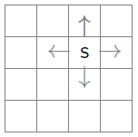
the Learning framework
Learning is performed online, learn as we interact with the world
In contrast with supervised learning, there are no training or test sets. The reward is accumulated over interactions with the environment.
Data is not fixed, more information is acquired as you go.
The training distribution can be influenced by action decisions.

Slide 24
Challenges
credit assignment problem: how do you know which actions were responsible for success or failure?
exploration vs exploitation: should you use your current model to collect rewards or should risk lower rewards now for a better model and higher rewards later?

Slide 25
Model-based Reinforcement Learning
Mechanism is Markov Decision Process
assume states and actions are known
assume states are fully observable
Approach:
learn the MDP reward and transition parameters
solve the MDP to determine an optimal policy
Appropriate when the model is unknown, but small enough to store and solve.

Slide 26
Learn the reward and transition distributions
Try every action in each state a number of times
RTotal(a,s) = total reward for action a in state s
N(a,s) = number of times action a taken in state s
N(a,s,s’) = number of transitions from s to s’ on action a
R(s,a) = RTotal(a,s) / N(a,s)
T(a,s,s’) = N(a,s) / N(a,s,s’)

Slide 27
reward parameter table
Actions
R(s0,a0) | R(s0,a1) | R(s0,a2)
R(s1,a0) | R(s1,a1) | R(s1,a2)
R(s2,a0) | R(s2,a1) | R(s2,a2)
R(s3,a0) | R(s3,a1) | R(s3,a2)
States

Slide 28
transition parameter Table
Action a
Next State
T(a,s0,s0) | T(a,s0,s1) | T(a,s0,s2) | T(a,s0,s3)
T(a,s1,s0) | T(a,s1,s1) | T(a,s1,s2) | T(a,s1,s3)
T(a,s2,s0) | T(a,s2,s1) | T(a,s2,s2) | T(a,s2,s3)
T(a,s3,s0) | T(a,s3,s1) | T(a,s3,s2) | T(a,s3,s3)
Current State

Slide 29
iterative improvement
Swap between learning the model and solving the model to determine the optimal policy
Why?
A poor policy may be expensive
might want to avoid learning a perfect model everywhere
How often should one solve the MDP?
it depends on the relative costs

Slide 30
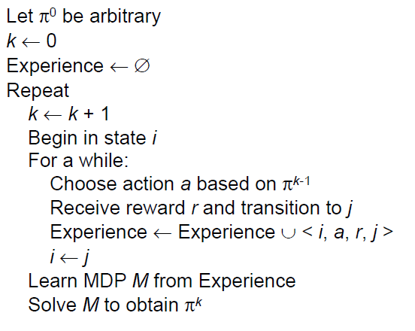
Model-based RL

Slide 31
credit assignment
How does model-based RL deal with the credit assignment problem?
Learned MDP tells us reward values and transition probabilities
Solving the MDP deals with long-term planning
So, the problem of credit assignment is solved optimally.

Slide 32
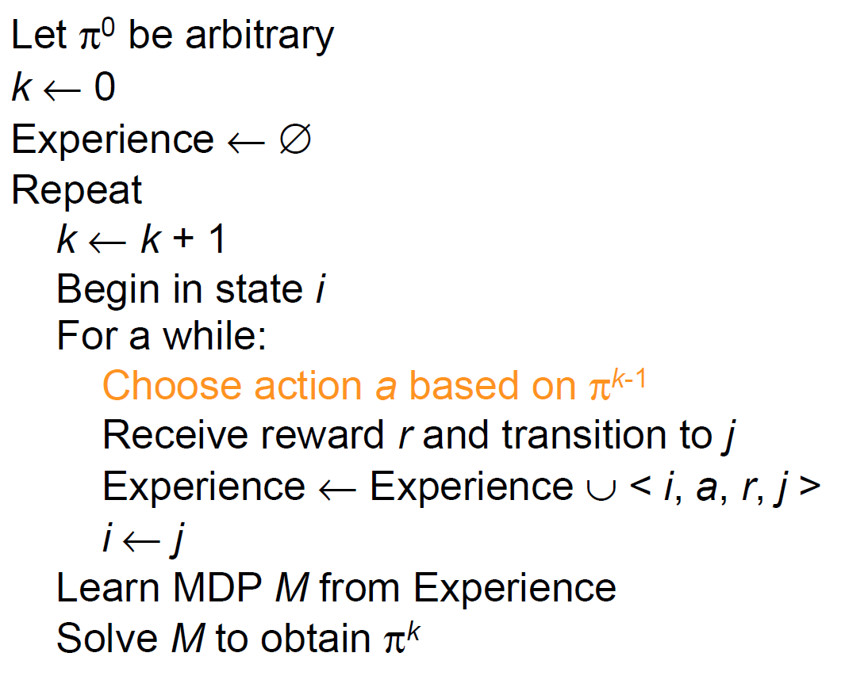
choosing an action

Slide 33
choosing an action: exploration vs exploitation
How should an agent choose an action? An obvious answer is simply follow the current policy. However, this is often the best way to improve your model.
Exploit: use your current model to maximize the expected utility now.
Explore: choose an action that will help you improve your model.

Slide 34
How/When should we explore / exploit ?
How to Exploit? use the current policy.
How to Explore?
choose an action randomly
choose an action you haven’t chosen yet
choose an action that will take you to an unexplored state.
When to exploit? When to explore? How much time in exploration vs time in exploitation?

Slide 35
convergence to the optimal policy
If:
every action is taken in every state infinitely often
the probability of exploration tends to zero
Then:
model-based RL will converge to the optimal policy
Choose exploration strategy that approximates these conditions.

Slide 36
exploration strategy 1: two stages
Explore until time T, then exploit
Weaknesses:
we may not explore log enough to get an accurate model
we may get stuck with a sub-optimal policy.
we may have to behave stupidly for a long time.
Uses:
appropriate if we only need to learn/solve MDP once
learn/solve in a simulation then act in the real world.

Slide 37


exploration strategy 2: $ε$-greedy
Explore with probability $ε.$ Exploit with probability $1−ε.$
Weaknesses:
Does not exploit when learning has converged.
Uses:
appropriate if the world is changing.

Slide 38

exploration strategy 3: Boltzmann
In state s, choose action a with probability p:
$$p=\frac{e^{\frac{Q(s,a)}{t}}}{\sum_{a′}{e^{\frac{Q(s,a′)}{t}}}}$$
Simulated annealing: t is a “temperature”
High temperature means more exploration
Over time, t cools, reducing exploration
Sensitive to cooling schedule.

Slide 39

exploration strategy 4: R-Max
Initialize reward for each state to $R_{max}$, the largest reward possible
Keep track of the number of times each state has been visited
After c visits, mark the state as known and update and update reward and transition probabilities.
Need to know $R_{max}$

Slide 40
Model-based rl: Pros and cons
Pros:
Makes maximal use of experience
Solves model optimally, given enough experience
Cons:
Assumes model is small enough to solve
Requires expensive solution procedure

Slide 41

Next Time: Q-learning
Q-learning uses the Q-function version of the Bellman equations:
$Q^{∗}\left(s,a\right)=R\left(s,a\right)+γ\sum_{s^{′}∈S}{P\left(s^{′} | s,a\right){\max_{a∈A}[Q}^{∗}\left(s^{′},a′\right)}]$, $∀s,a$
Q-learning dispenses with learning a model, but tries to learn the Q function directly from which you can read off the policy.
It is appropriate to use when the model is too large to solve or learn.

Slide 42
bellman equations
The planning problem for an MDP is:
$$π^{∗}∈\underset{π}{arg max}{V^{π}(s)}$$
Bellman equations:
$V^{∗}\left(s\right)=\max_{a∈A}\left[R\left(s,a\right)+γ\sum_{s^{′}∈S}{P\left(s^{′} | s,a\right)V^{∗}\left(s^{′}\right)}\right], ∀s$
All MDP algorithms use some variant of the Bellman equations.

Slide 43

bellman equations using q-function
The planning problem for an MDP is:
$$π^{∗}∈\underset{π}{arg max}{Q^{π}(s,a)}$$
Q-Function version of Bellman equations:
$Q^{∗}\left(s,a\right)=R\left(s,a\right)+γ\sum_{s^{′}∈S}{P\left(s^{′} | s,a\right){\max_{a∈A}[Q}^{∗}\left(s^{′},a′\right)}]$, $∀s,a$

